Slide 1
THE GREEN MARKET

Slide 2
What is The Green Market?
TWO-WAY MARKETPLACE
Designed for users of various backgrounds to be able to buy and sell their own plants as a hobby or as a primary source of income.
A user can both buy and sell plants using the one account.
BY A PLANT COLLECTOR, FOR OTHER PLANT COLLECTORS.
As a plant collector and hobbyist myself, I understand what others like me look for in a marketplace when it comes time to sell some of my plants.
I was able to use this knowledge to implement relevant and useful features in the application.

Slide 3
The problem...
Price Inflation
Due to plant sales being scattered across multiple platforms, designer labelling and misinformation, many plants are being sold for a massively inflated price. When all plants are on the one platform, sellers can easily see what others are selling their same species for and adjust their price accordingly.
Inconsistent Identification
Because of users of varying experience all can sell their plants, many can be misidentified and mislabelled. Though often this happens with no malise, sometimes a seller will list a very similar looking plant as its much rarer, more expensive twin.

Slide 4
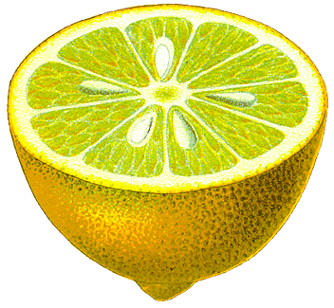
The solution.
The Green Market works to combat these problems by bringing buyers and sellers to a single application.

Slide 5
Let’s walk through the app.

